Slide 1
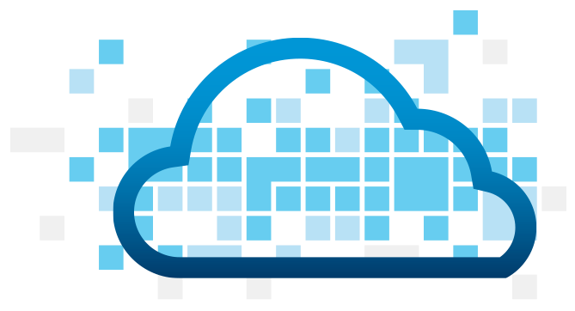
API Management Tools
Cloud Foundry and Microservices
Wang Yi
ywang@pivotal.io
Notes:
Basic Intro - Matt Stine, Platform Engineer, CF Team
Today I’d like to talk a little bit about continuous delivery and how you architect for that.

Slide 2
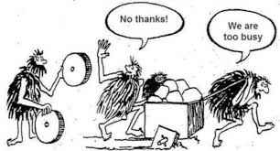

Slide 3

Microservices Overview
Notes:
So let’s do a brief overview of the microservices architectural style…but first <TRANSITION>

Slide 4
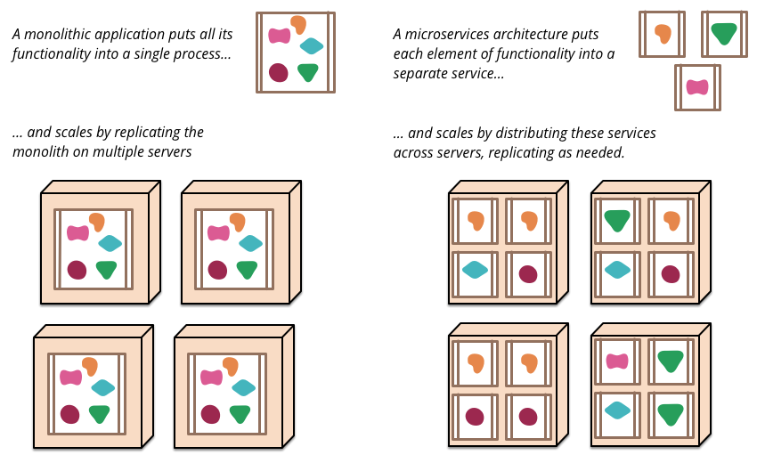
Microservice
Notes:
So how do you do that?
By making the first task on any software effort “delivery” - deploy the code somewhere, even if it doesn’t do anything.
And then keep doing that every time you change anything…

Slide 5
Monolithic Architectures
Catalog
User
Registration
Search
Orders
Profile
Account
Recommendation
Lists

Slide 6
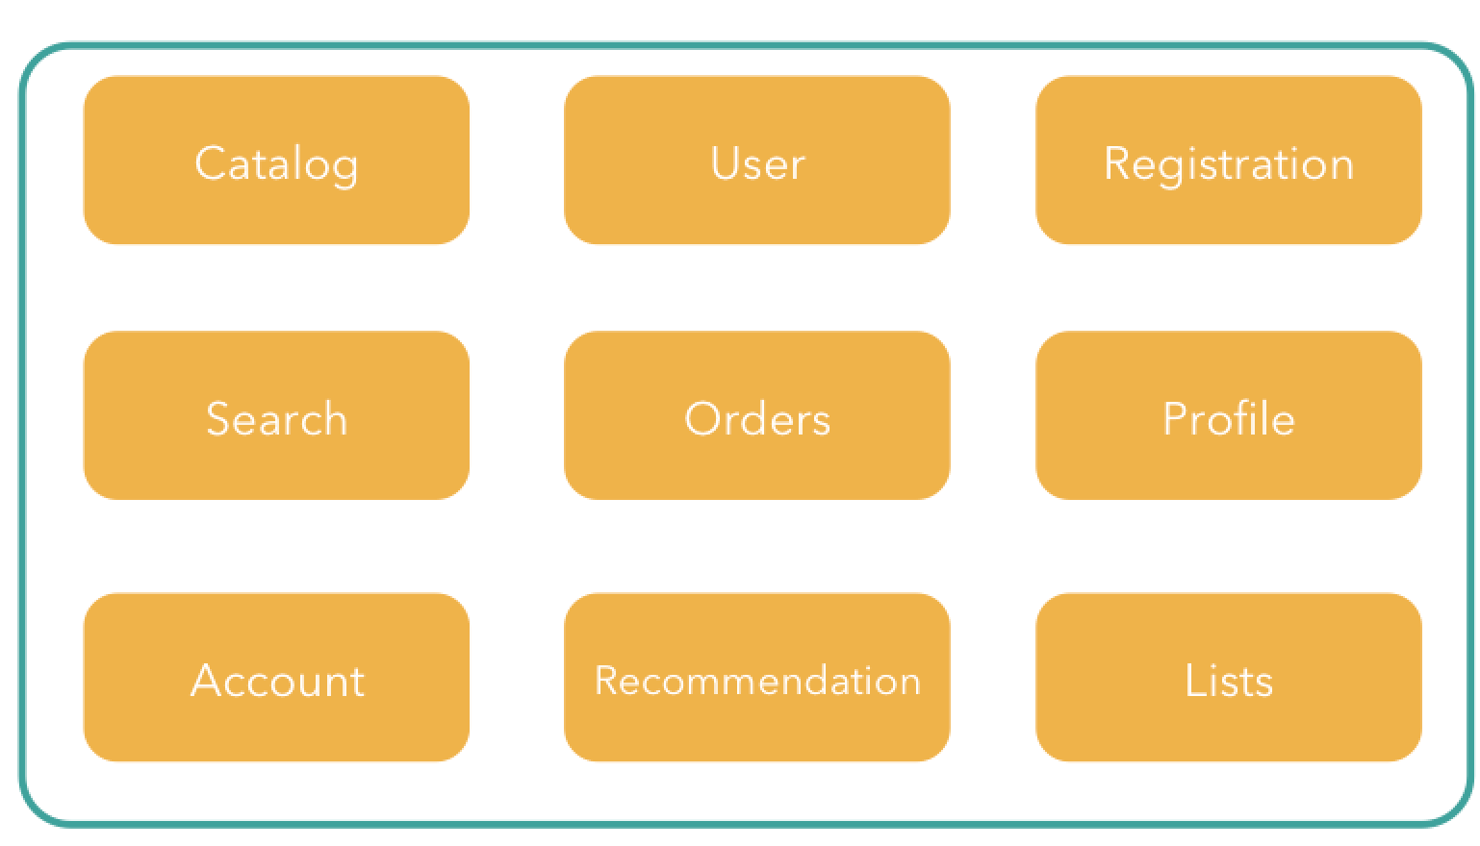


Low Productivity – Communications & Management
BUSINESS
PROJECTS
OPS
TECH, OPS & APP MGMT.
DBAs
SUPPORT
PROJECT TEAMS
STAKEHOLDERS
TRADITIONAL, PROJECT-BASED ORG
SYSTEMS
USERS
CONCEPT TO CASH

Slide 7
Scaling Monolithic Architectures
Catalog
User
Registration
Catalog
User
Registration
Catalog
User
Registration
Catalog
User
Registration
Catalog
User
Registration
Catalog
User
Registration
Catalog
User
Registration
Catalog
User
Registration
Search
Orders
Profile
Search
Orders
Profile
Search
Orders
Profile
Search
Orders
Profile
Search
Orders
Profile
Search
Orders
Profile
Search
Orders
Profile
Search
Orders
Profile
Account
Recommendation
Lists
Account
Recommendation
Lists
Account
Recommendation
Lists
Account
Recommendation
Lists
Account
Recommendation
Lists
Account
Recommendation
Lists
Account
Recommendation
Lists
Account
Recommendation
Lists

Slide 8
Linear scalability?

Slide 9







Microservice Architecture
Relational
DB
HTTP
HTTP
Key/Value
Store
HTTP
HTTP
HTTP
…
AMQP
AMQP
HTTP
Graph
DB
Notes:
REST and message-driven services
Polyglot persistence, services encapsulate data store semantics
Diversity of clients acknowledged
API Gateway for service aggregation, reduce chattiness, protocol translation, reduce latency/round-trips, deal with mobile device fragmentation, build use case/device specific API’s

Slide 10

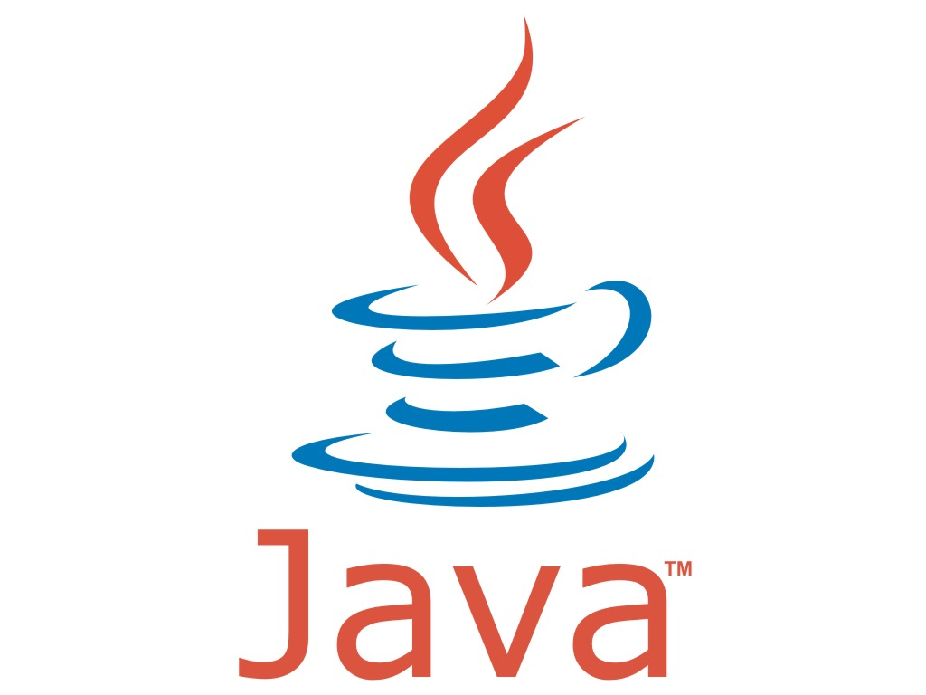
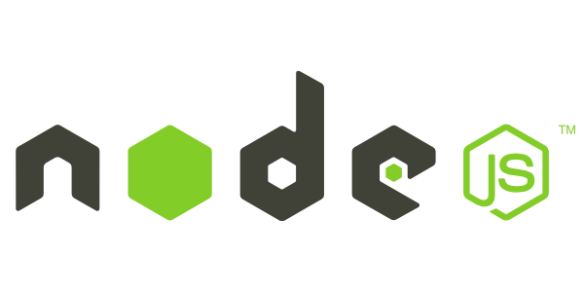
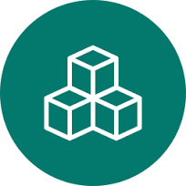


Right tool for the right job
Search
Catalog
Orders
Search
Catalog
Search

Slide 11
Microservice Benefits
The services themselves are very simple, focussing on doing one thing well;
Each service can be built using the best and most appropriate tool for the job;
Systems built in this way are inherently loosely coupled;
Multiple developers and teams can deliver relatively independently of each other under this model;
They are a great enabler for continuous delivery, allowing frequent releases whilst keeping the rest of the system available and stable.

Slide 12
Cool, but I don’t quite get it why do I need it !

Slide 13
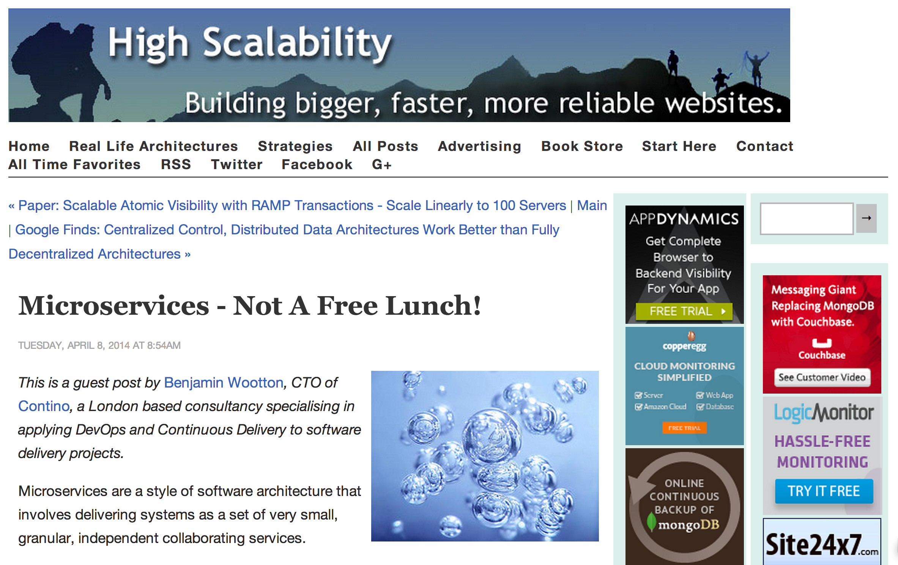
http://highscalability.com/blog/2014/4/8/microservices-not-a-free-lunch.html
Notes:
So to finish up, I’d like to take a look at the challenges associated with developing a microservices architecture.
Benjamin Wootton published an excellent article a couple of months ago at High Scalability entitled “Microservices - Not a Free Lunch!” In it he does an excellent job summarizing many of the challenges that you’ll encounter as you travel down the microservices road.

Slide 14
No Free Lunch
Significant Operations Overhead
Substantial DevOps Skills Required
Implicit Interfaces
Duplication Of Effort
Distributed System Complexity
Asynchronicity Is Difficult
Testability Challenges

Slide 15
Ad hoc small apps
United government data and API sharing platform

Slide 16
Not Traditional (ESB-centric) SOA
UI
Service
Service
Service
Service
UI
Enterprise Service Bus
Service
Service
Service
Service

Slide 17
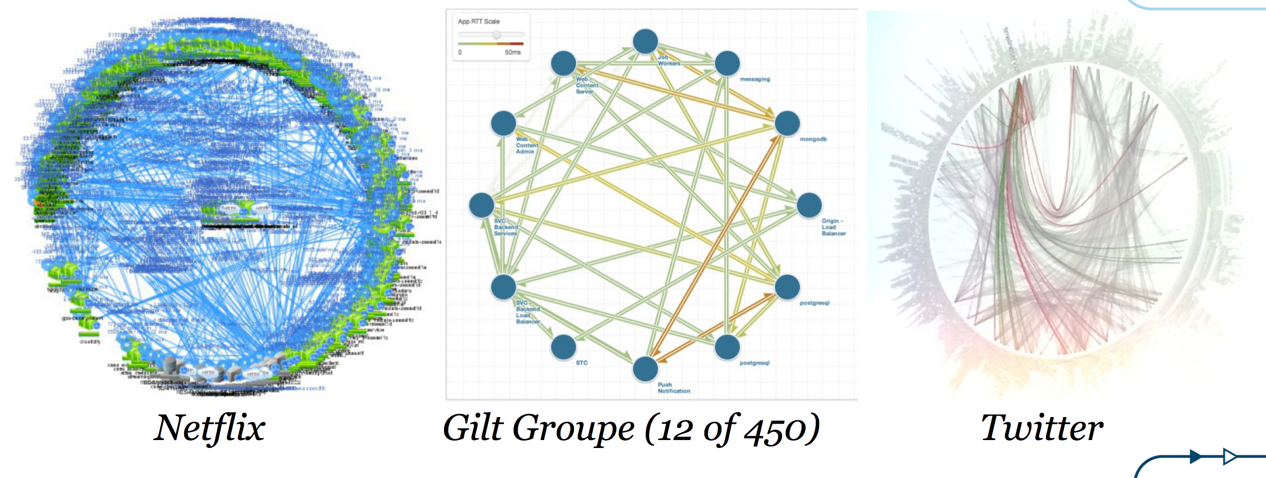
But Microservices!

Slide 18
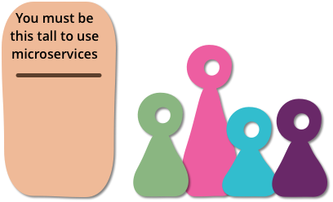
There’s no free lunch
Rapid provisioning
Basic Monitoring
Rapid application deployment
http://martinfowler.com/bliki/MicroservicePrerequisites.html

Slide 19







Spring Cloud Netflix components
Ribbon
Archaius
Hystrix
Feign
Zuul
Client
Eureka
Turbine
Server
Notes:
Ribbon: A client load balancer. Ribbon loads routing info from Eureka. It has several implementations of load balancing rules. Ribbon is used internally by Feign
Feign: A declarative REST client. Allows annotation of interface to be mapped to endpoints. When combined with Ribbon it adds load balancing capabilities to the client interface
Hystrix: Circuit breaker patter implementation. Via spring annotations add commands to methods using AOP. Protects clients from failures and reports metrics via a stream of HTTP events
Zuul: A set of HTTP filters do add routing, security. On spring its used to create a CORS filter for UI apps to be able to access external services
Archaius: Dynamic configuration management. Used with Spring’s config server to allow dynamic properties loading
Eureka: Discovery server
Turbine: Event aggregation engine. It can combine several streams (hystrix) into one combined view, that can be view later on a dashboard

Slide 20
Netflix OSS
Ribbon: A client load balancer. Ribbon loads routing info from Eureka. It has several implementations of load balancing rules. Ribbon is used internally by Feign
Feign: A declarative REST client. Allows annotation of interface to be mapped to endpoints. When combined with Ribbon it adds load balancing capabilities to the client interface
Hystrix: Circuit breaker patter implementation. Via spring annotations add commands to methods using AOP. Protects clients from failures and reports metrics via a stream of HTTP events
Zuul: A set of HTTP filters do add routing, security. On spring its used to create a CORS filter for UI apps to be able to access external services
Archaius: Dynamic configuration management. Used with Spring’s config server to allow dynamic properties loading
Eureka: Discovery server
Turbine: Event aggregation engine. It can combine several streams (hystrix) into one combined view, that can be view later on a dashboard

Slide 21
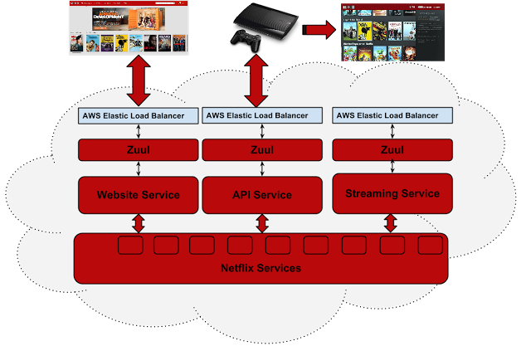
Netflix API Implementation
Notes:
Ribbon: A client load balancer. Ribbon loads routing info from Eureka. It has several implementations of load balancing rules. Ribbon is used internally by Feign
Feign: A declarative REST client. Allows annotation of interface to be mapped to endpoints. When combined with Ribbon it adds load balancing capabilities to the client interface
Hystrix: Circuit breaker patter implementation. Via spring annotations add commands to methods using AOP. Protects clients from failures and reports metrics via a stream of HTTP events
Zuul: A set of HTTP filters do add routing, security. On spring its used to create a CORS filter for UI apps to be able to access external services
Archaius: Dynamic configuration management. Used with Spring’s config server to allow dynamic properties loading
Eureka: Discovery server
Turbine: Event aggregation engine. It can combine several streams (hystrix) into one combined view, that can be view later on a dashboard

Slide 22
API Management
Design
Documentation
Analytics
Universal Access
Uptime

Slide 23
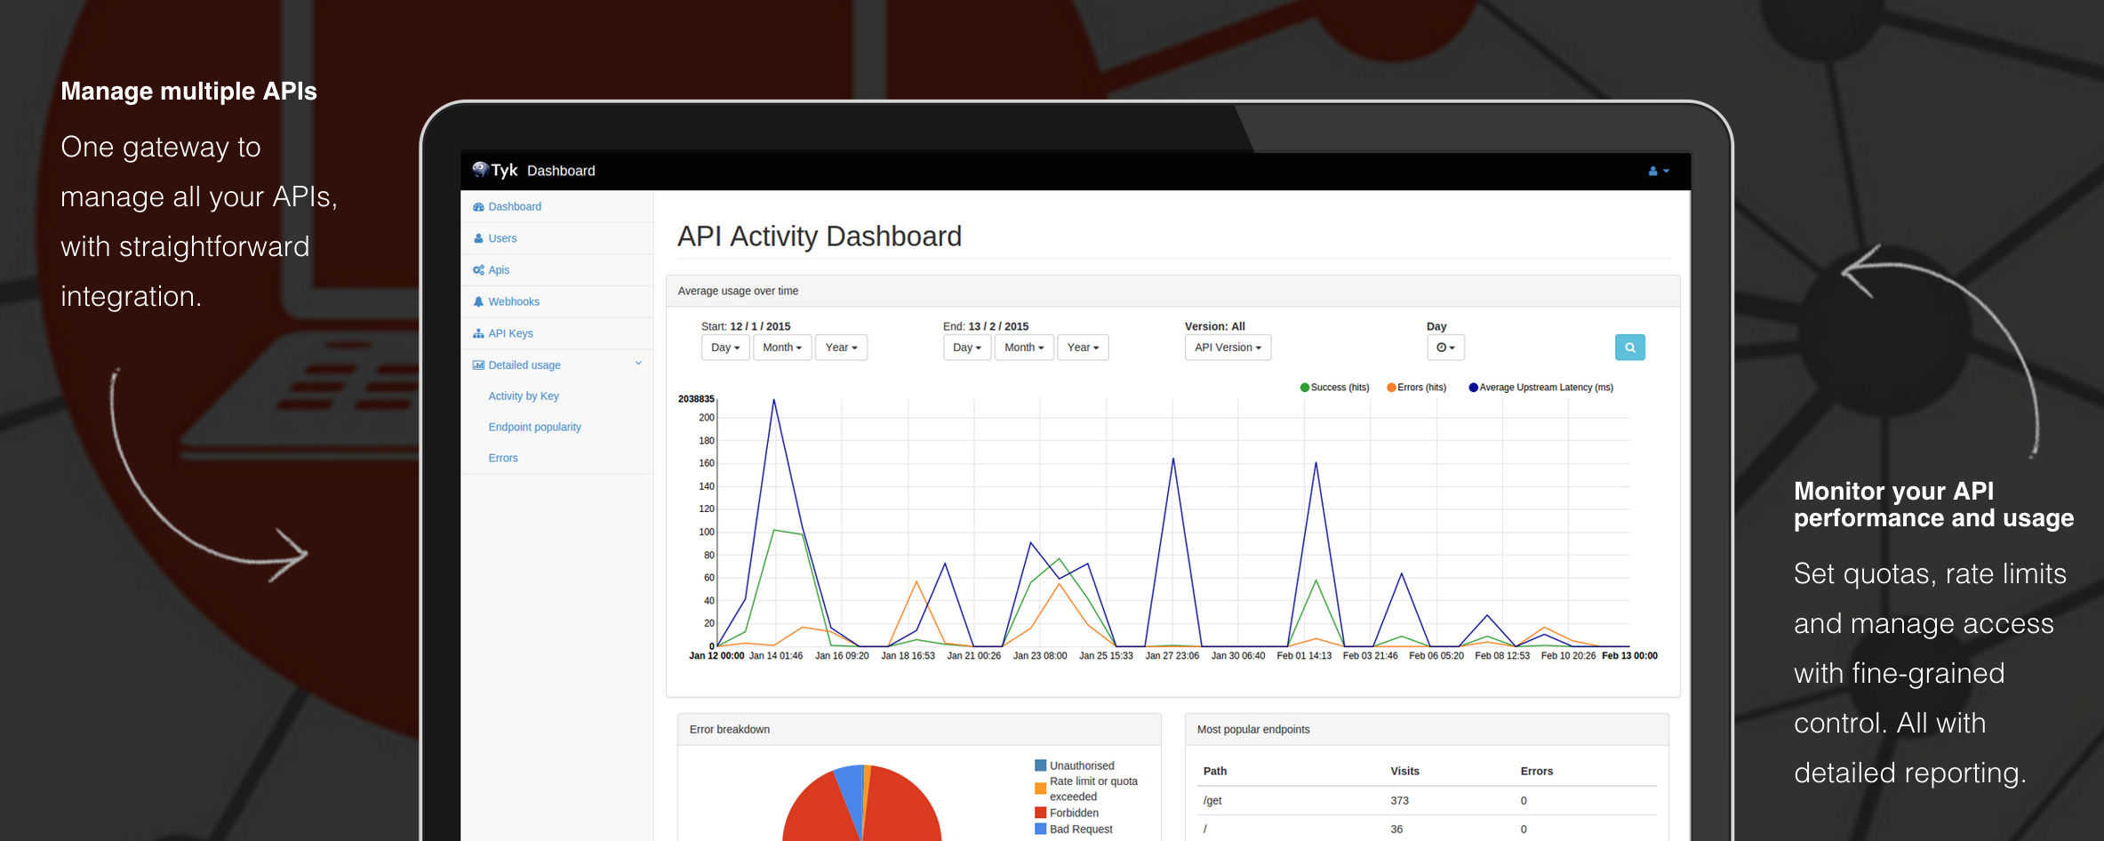
TYK

Slide 24
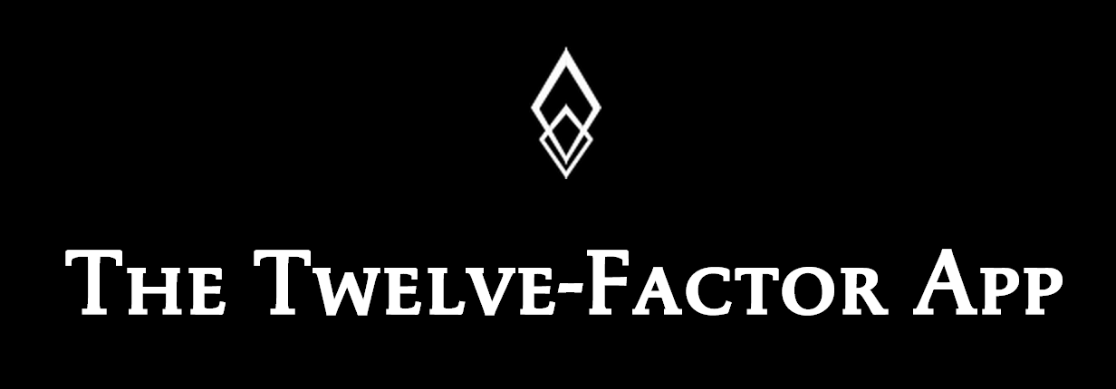
Cloud Native Application
http://12factor.net
Notes:
So now I’ll switch gears and give a brief overview of the twelve-factor application and how Cloud Foundry is tuned to support applications developed in that style.

Slide 25
Cloud Benefits - IaaS
Flexibility
Lightweight, Consolidation
Fast Provision
High Availability, Uptime
Scale On Demand
Operation Agility, Streamline Process

Slide 26
Again, Not Free Especially For the App

Slide 27
Application Need To
Application Modernization, Re-Architecting, Re-Design and Re-Write
Portable
Lightweight
End to End Scalability
End to End High Availability
Virtual Aware

Slide 28
How An App Looks Like
APP
UI
API
Web Container
War
MQ
Data Store
Cache
File
API

Slide 29

12 Factor Apps
I. Codebase
II. Dependencies
III. Configuration
IV. Backing services
V. Build, release, run
VI. Process
VII. Port binding
VIII. Concurrency
X. Dev/Prod parity
XII. Admin Process
IX. Disposability
XI. Logs

Slide 30
Twelve Factors
One Codebase/Many Deploys
Explicit Isolated Dependencies
Config via Environment
Attached Backing Services
Separate Build/Release/Run
Stateless Processes
Export Services via Port Bindings
Scale Out via Processes
Disposable Instances
Dev/Prod Parity
Logs == Event Streams
Admin Tasks == Processes
http://12factor.net

Slide 31


It takes a platform…
Pivotal CF
Spring Cloud
Notes:
We want to encapsulate as much of the technology

Slide 32
Labs
Notes:
So let’s do a brief overview of the microservices architectural style…but first <TRANSITION>

Slide 33
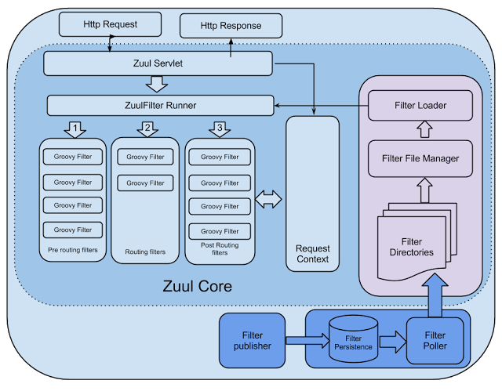
Notes:
So how do you do that?
By making the first task on any software effort “delivery” - deploy the code somewhere, even if it doesn’t do anything.
And then keep doing that every time you change anything…

Slide 34
Data Exchange Strategy
Notes:
So let’s do a brief overview of the microservices architectural style…but first <TRANSITION>

Slide 35
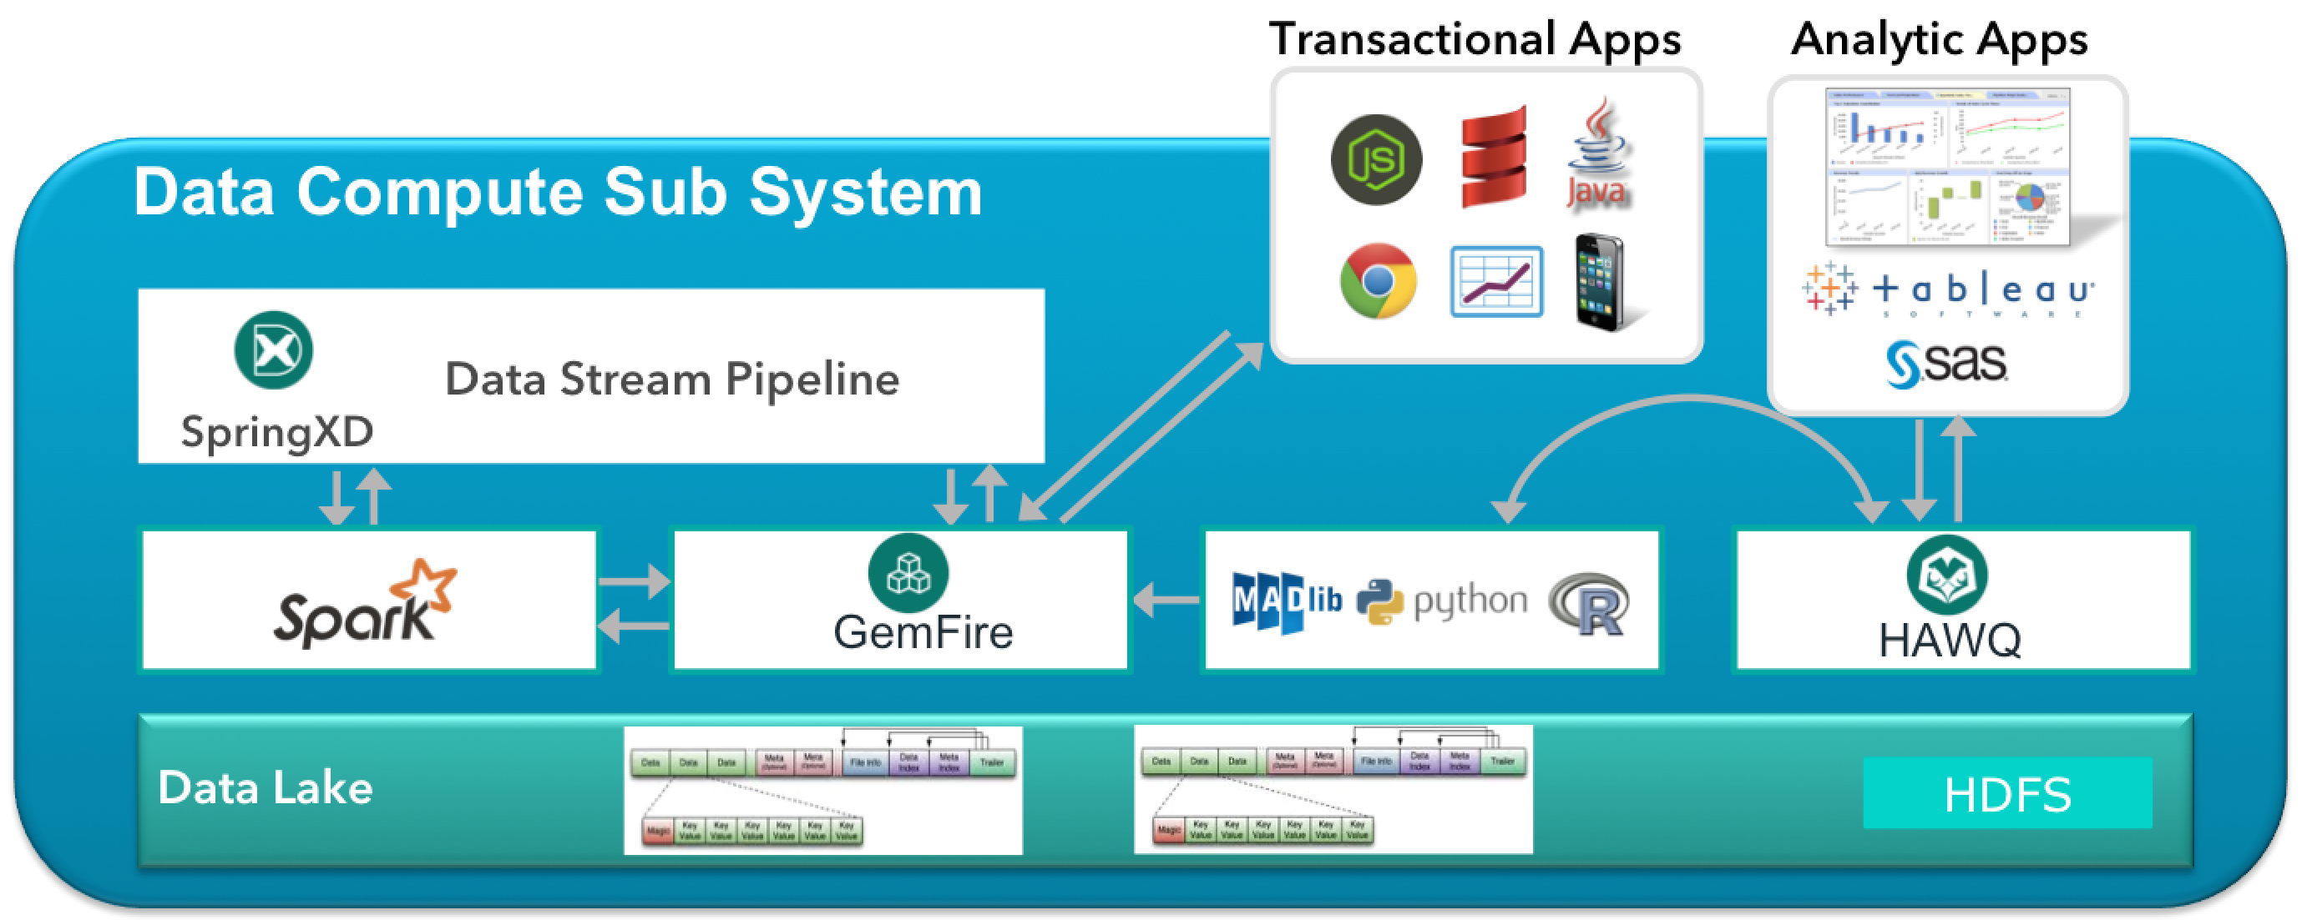
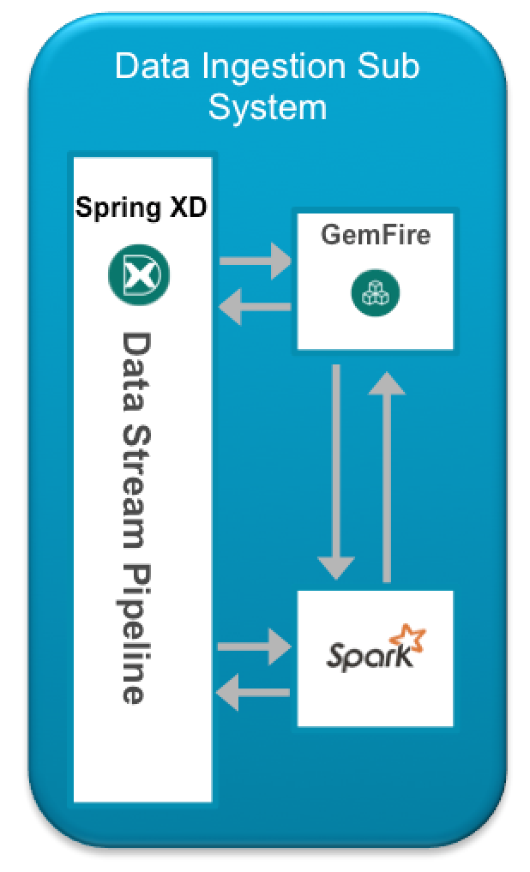
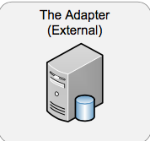
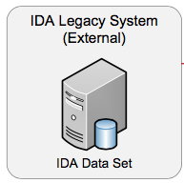
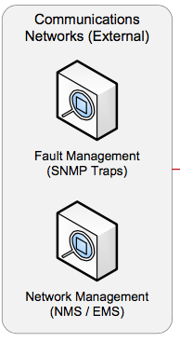
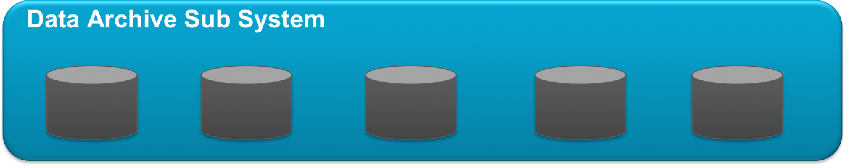
Proposed Big Data Application Architecture
Queries
Queries
Speed Process
Micro Batch/Batch Process

Slide 36
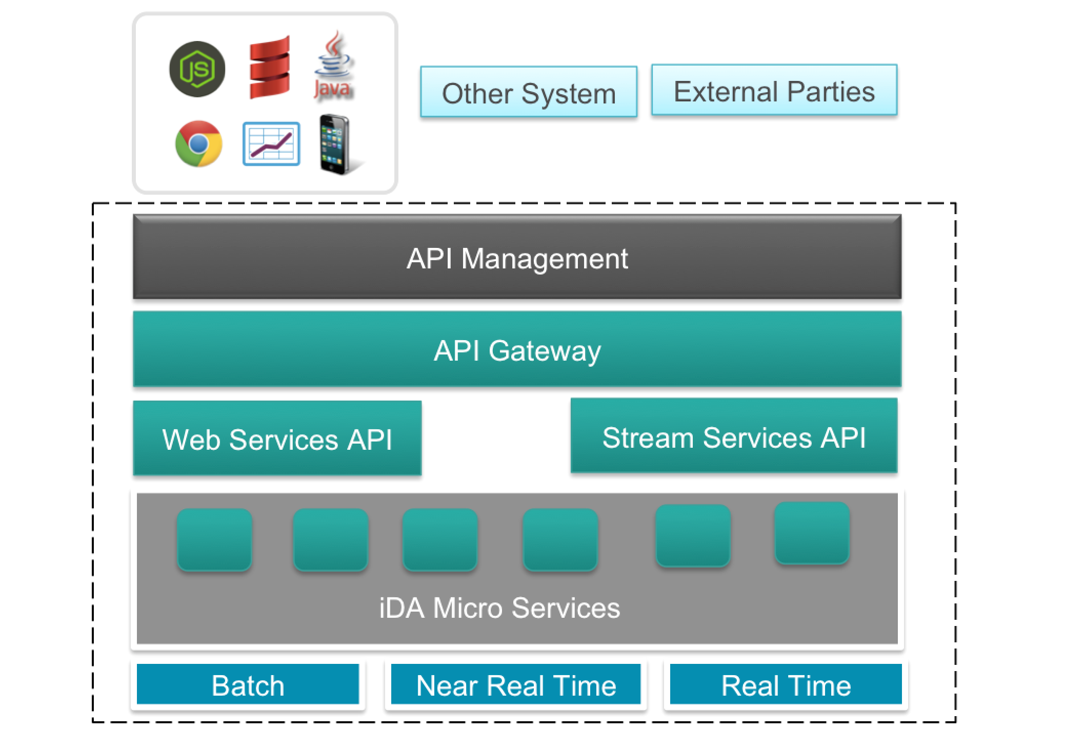
Data As A Service

Slide 37
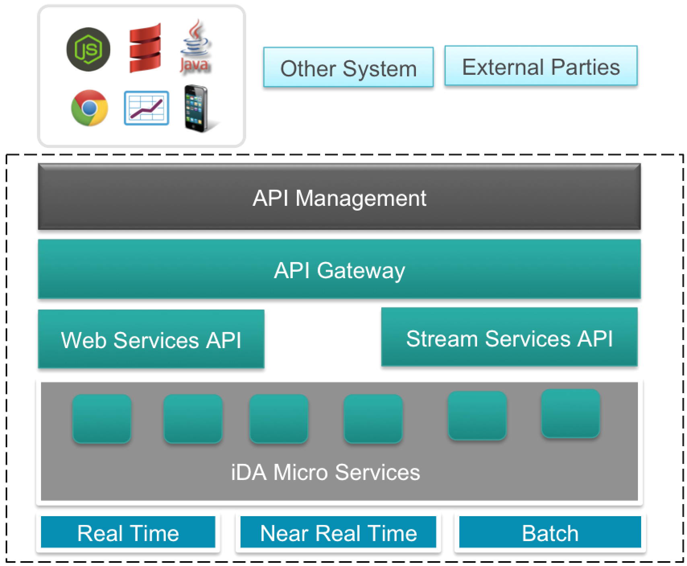


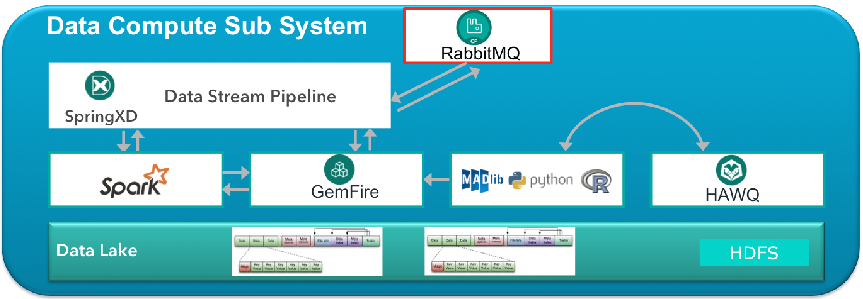
Data Exchange Integration
Spring Boot

